Slide 1
Extracting plate numbers and addresses
CS 415 Team 2
Arthi Aneel
Chandhu Bhumireddy
Hal Brynteson
Nygel Sotomayor
Venkata Pidaparthi

Slide 2
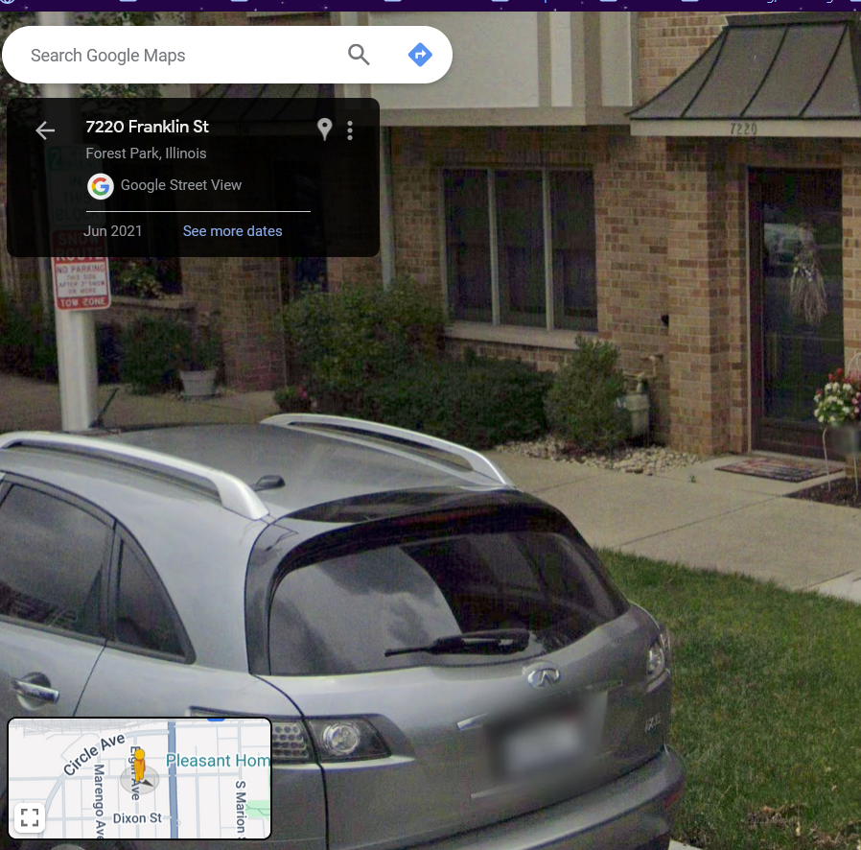
Problems Addressed
Can we extract numbers and determine their source?
This is useful for something like Google Street View, were the source of a number effects how it is used.
House numbers are extracted and displayed
Car numbers are blurred

Slide 3
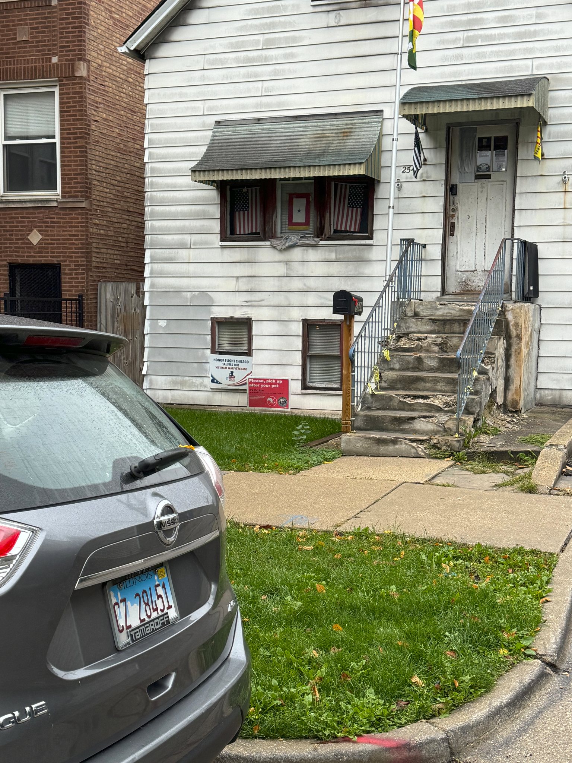
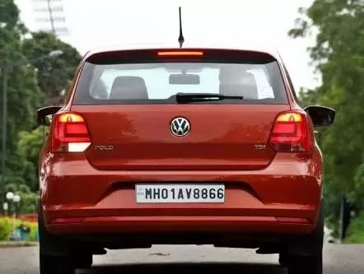
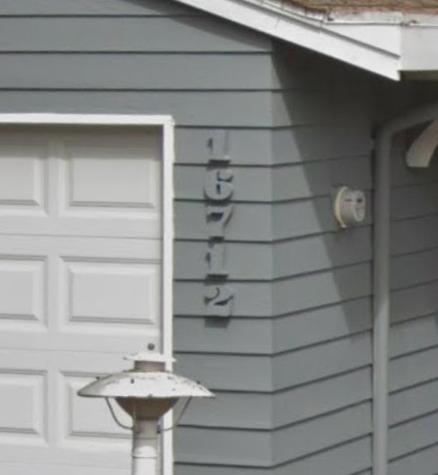
Dataset
Our dataset contains images of car and house numbers, each image having the following labels:
Number source: Car, House, or Both
Clarity: Clear or Unclear
Clear Images are high resolution, high contrast images with little text distortion
Unclear images are low resolution, low contrast, or with heavy text distortion.
Text
Both, unclear
Car, unclear
House, unclear
Notes:
Also explain source datasets (Street View and KPU, plus sizes). We made our own set of 91 images.

Slide 4
Approaches Used
Zero-shot object detection with OWL-ViT
Extract car patches
Detect and extract plate patches
Process character patches
Extract numbers with Easy OCR
cars detected
Use Keras OCR to detect and extract text patches
no cars detected
First, we use OWL-ViT to perform zero-shot object detection to find car patches, and, if applicable, plates
Then, for both car and non-car (or, house) patches, we detect all text using Easy OCR.
If the basic text detection contains any numbers, we process for better clarity
Finally, the processed patches, labeled either for cars or non-cars, have the numbers extracted.
Notes:
Make sure to clarify that we focus on car and house numbers, so we assume any non-car numbers are house numbers

Slide 5
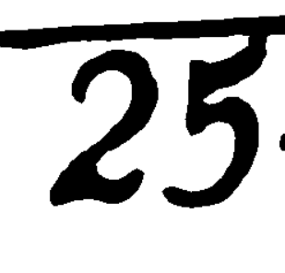
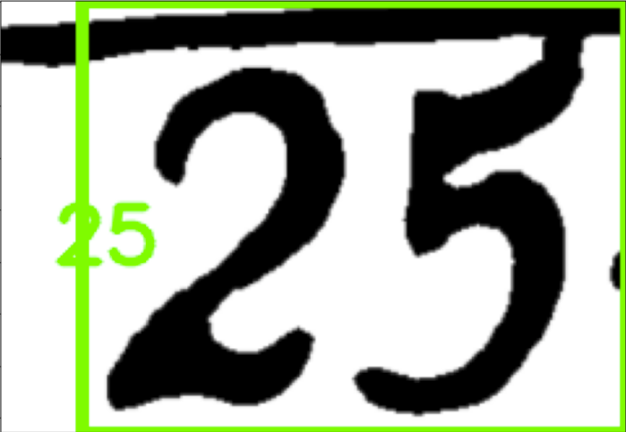

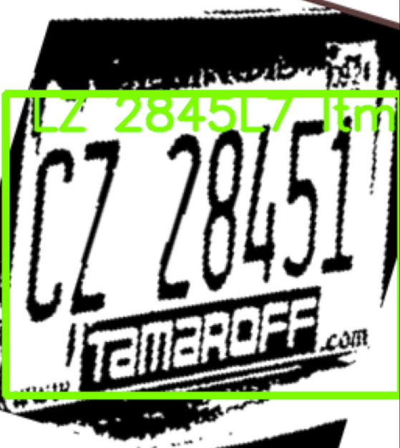
Approaches Used
Extract based on object
Text Recognition
Image
Crop text
Process
Result
House:
25
Car:
LZ 2845L7
Notes:
Make sure to clarify that we focus on car and house numbers, so we assume any non-car numbers are house numbers

Slide 6

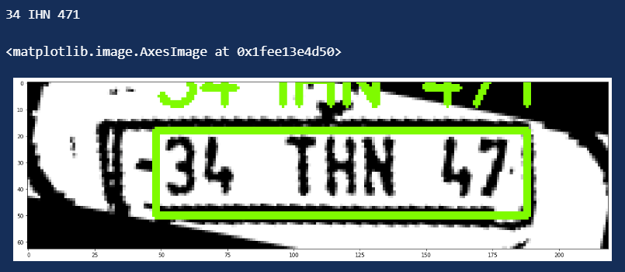

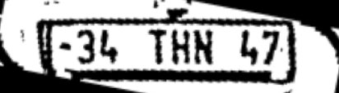
Processing Approach
Upscale Patch
Run OCR
OTSU Binarization
Deskew

Slide 7
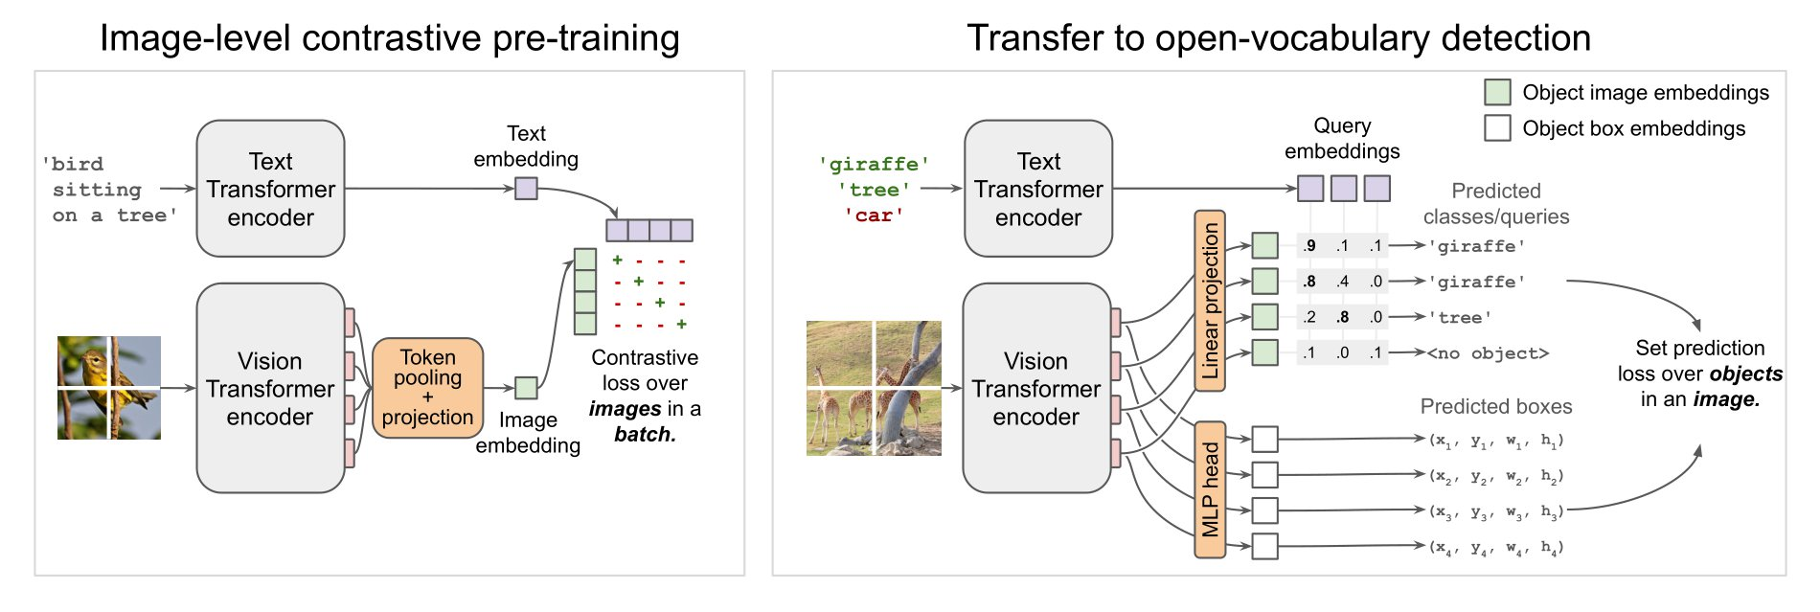
Approaches Used
OWL-ViT is a zero-shot text-conditioned object detection model which uses CLIP as its multi-modal backbone, with a ViT-like Transformer to get visual features and a causal language model to get the text features. To use CLIP for detection, OWL-ViT removes the final token pooling layer of the vision model and attaches a lightweight classification and box head to each transformer output token.
Notes:
Make sure to clarify that we focus on car and house numbers, so we assume any non-car numbers are house numbers

Slide 8
Evaluation Measures (Object Detection)
We then measured the following:
For object detection:
How many false positives and false negatives when detecting “car”?
Does this differ based on clarity?
Notes:
For the source, we track false positives (cars where there are no cars) and false negatives (no cars where there are cars).
For the text, we measure how many characters are detected correctly to get a character accuracy. Labeled based on clarity and checked against them

Slide 9
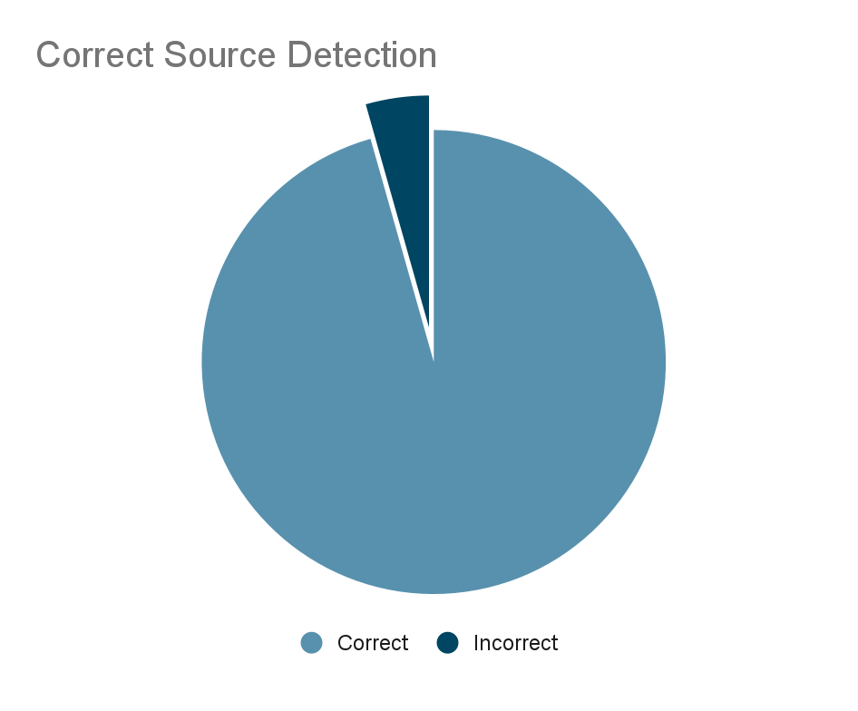
Resulting Performances - Object Detection
For object detection:
Time: 4m 2.5s
Accuracy: 87 out of 91 detected correctly, for a 95% accuracy
Of the 4 detected incorrectly, all were false negatives, where no car was found in a “car” image.
Of the 4 false negatives, 3 were labeled “unclear”

Slide 10
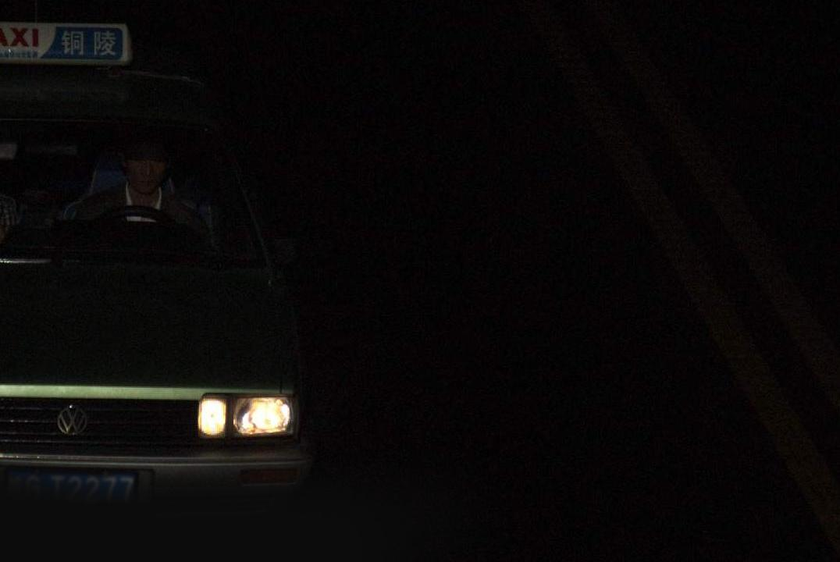
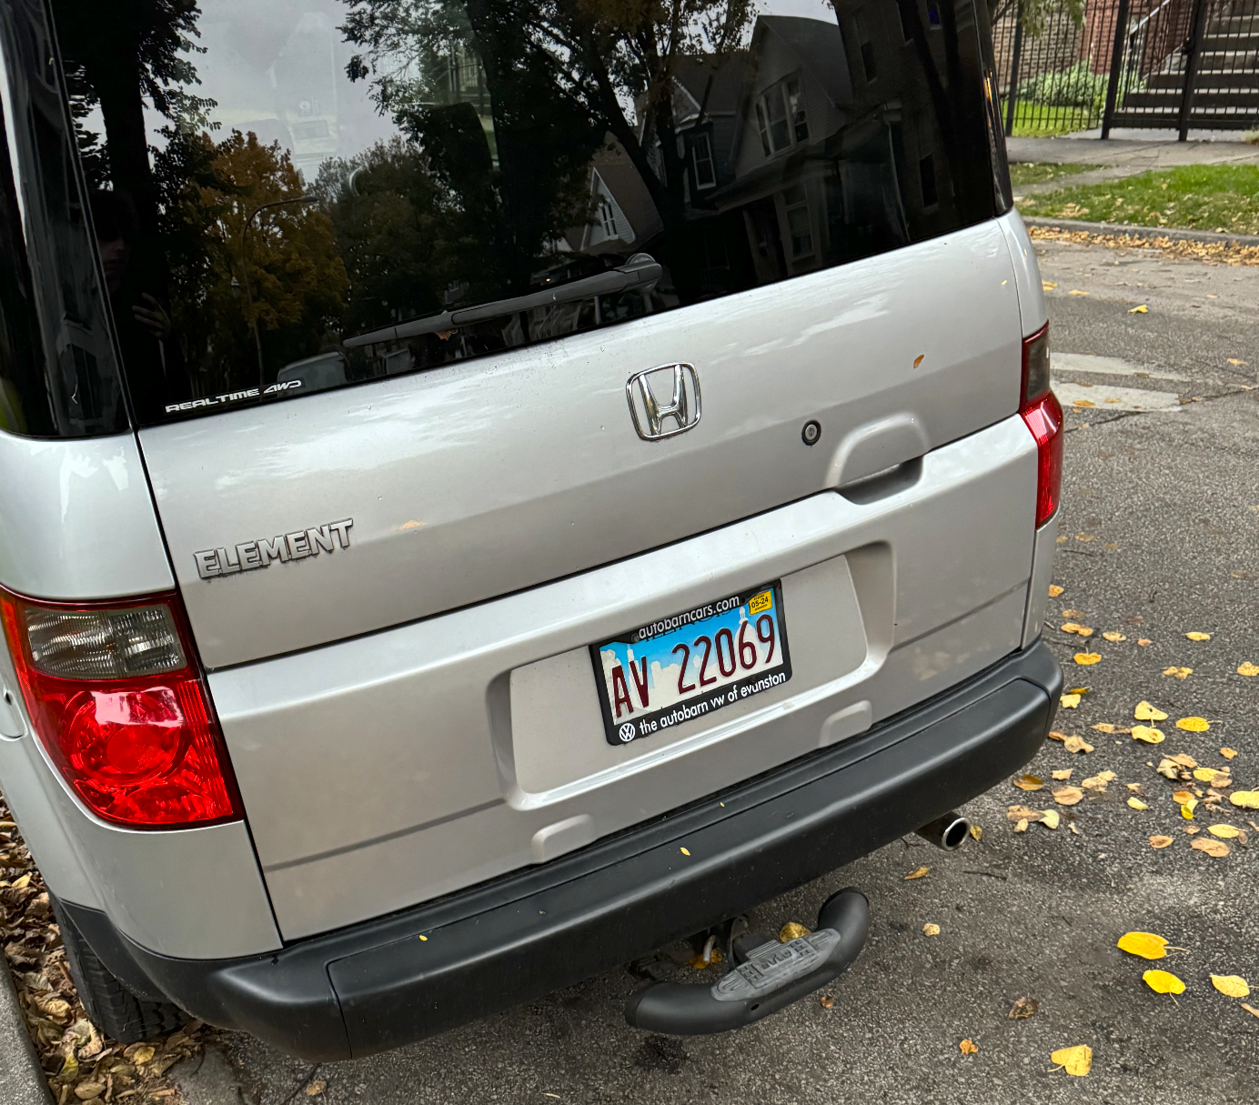
Resulting Performances - Object Detection
“Unclear” false negative
“Clear” false negative

Slide 11
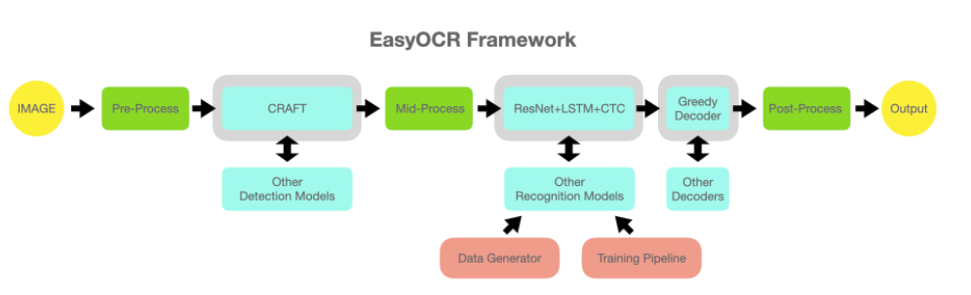
Approaches Used
EasyOCR is a lightweight OCR library designed to extract text from images. It utilizes deep learning techniques, specifically convolutional neural networks (CNNs), to recognize and interpret characters within images or scanned documents. It supports the use of either CPU based processing or GPU supported processing with support for only NVIDIA Cuda cores.
Notes:
Make sure to clarify that we focus on car and house numbers, so we assume any non-car numbers are house numbers

Slide 12
Evaluation Measures - Text Recognition
We then measured the following:
For text detection:
Was text detected?
If so, how accurate was the extracted text to the actual text (percentage of correct characters)?

Slide 13
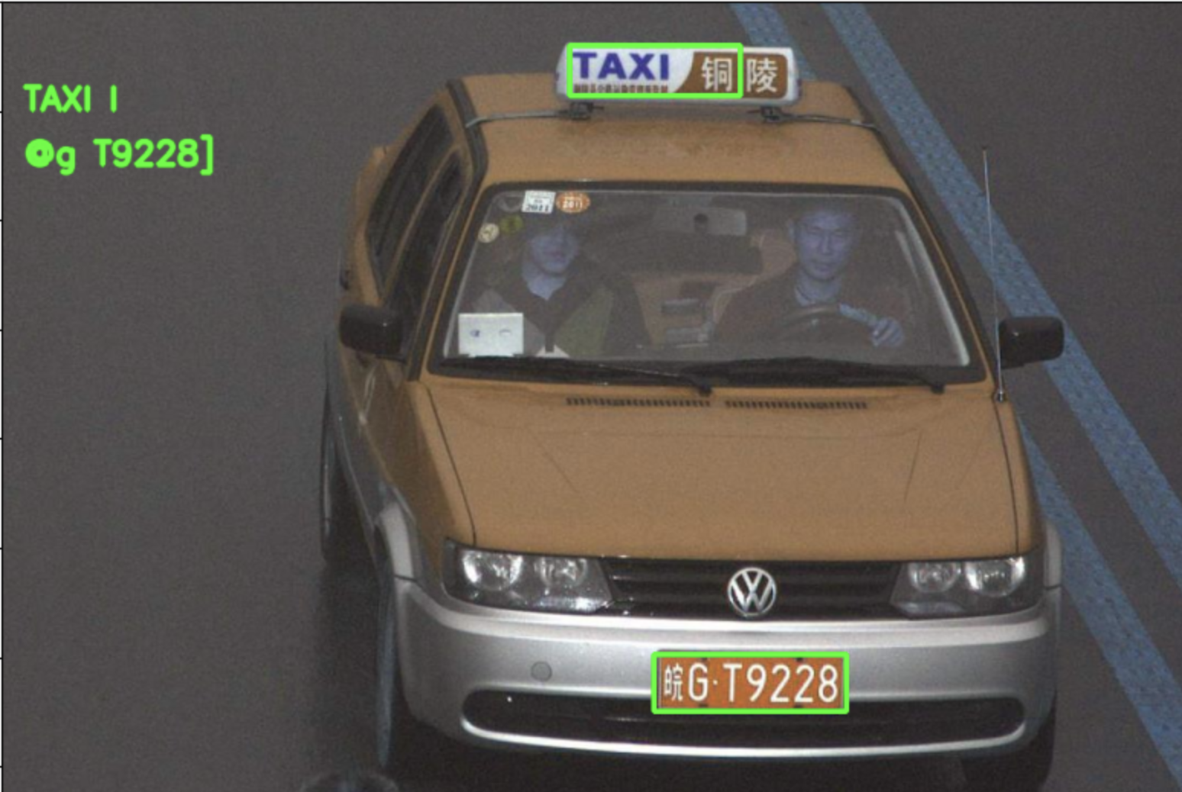
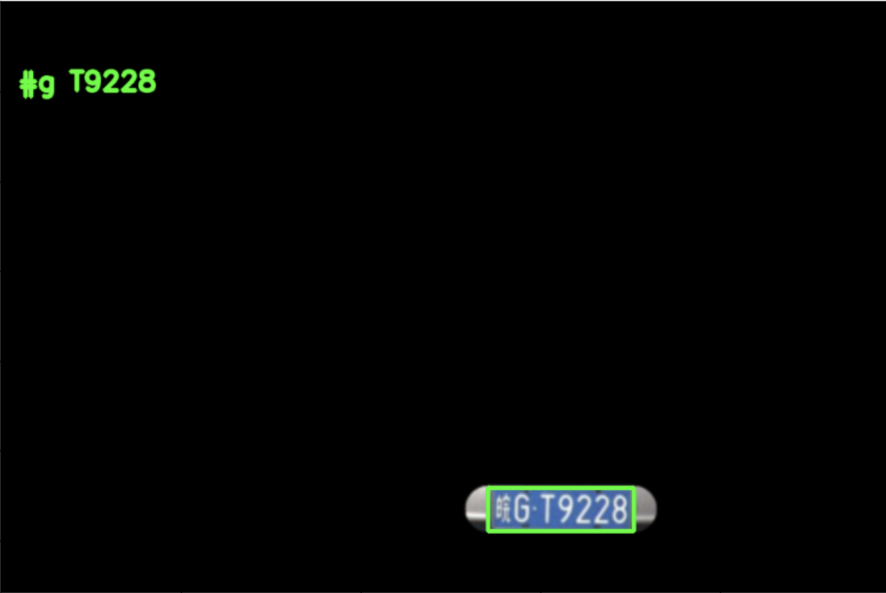
EasyOCR Output
EasyOCR without pre-processing
EasyOCR with pre-processing

Slide 14
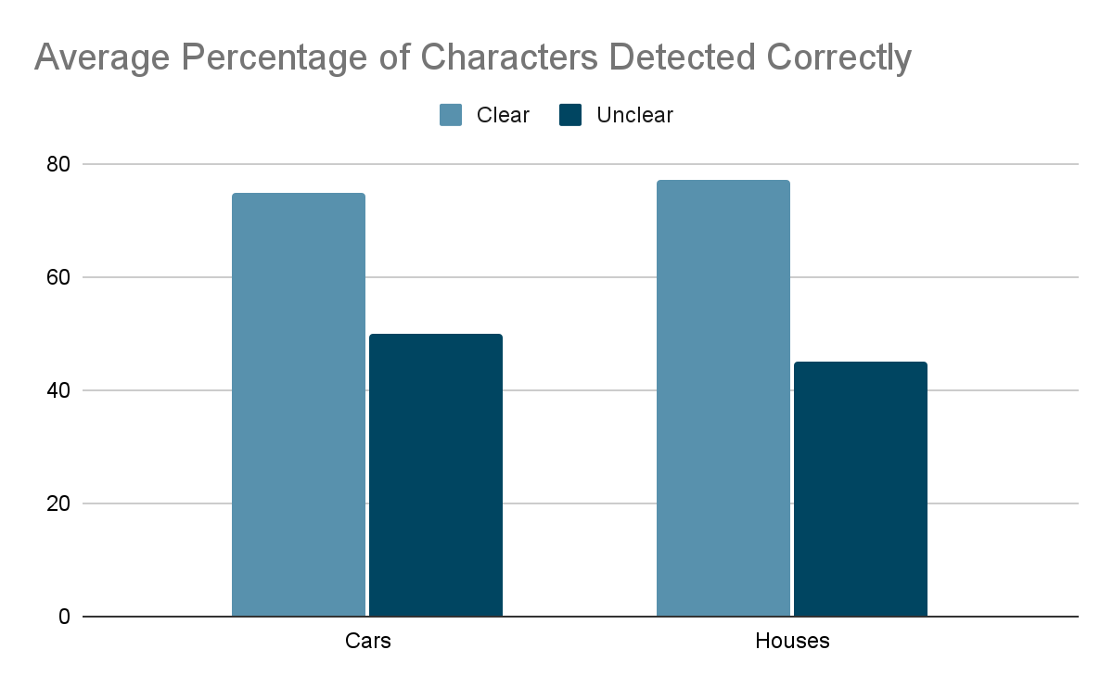
Resulting Performances - Text Recognition

Slide 15
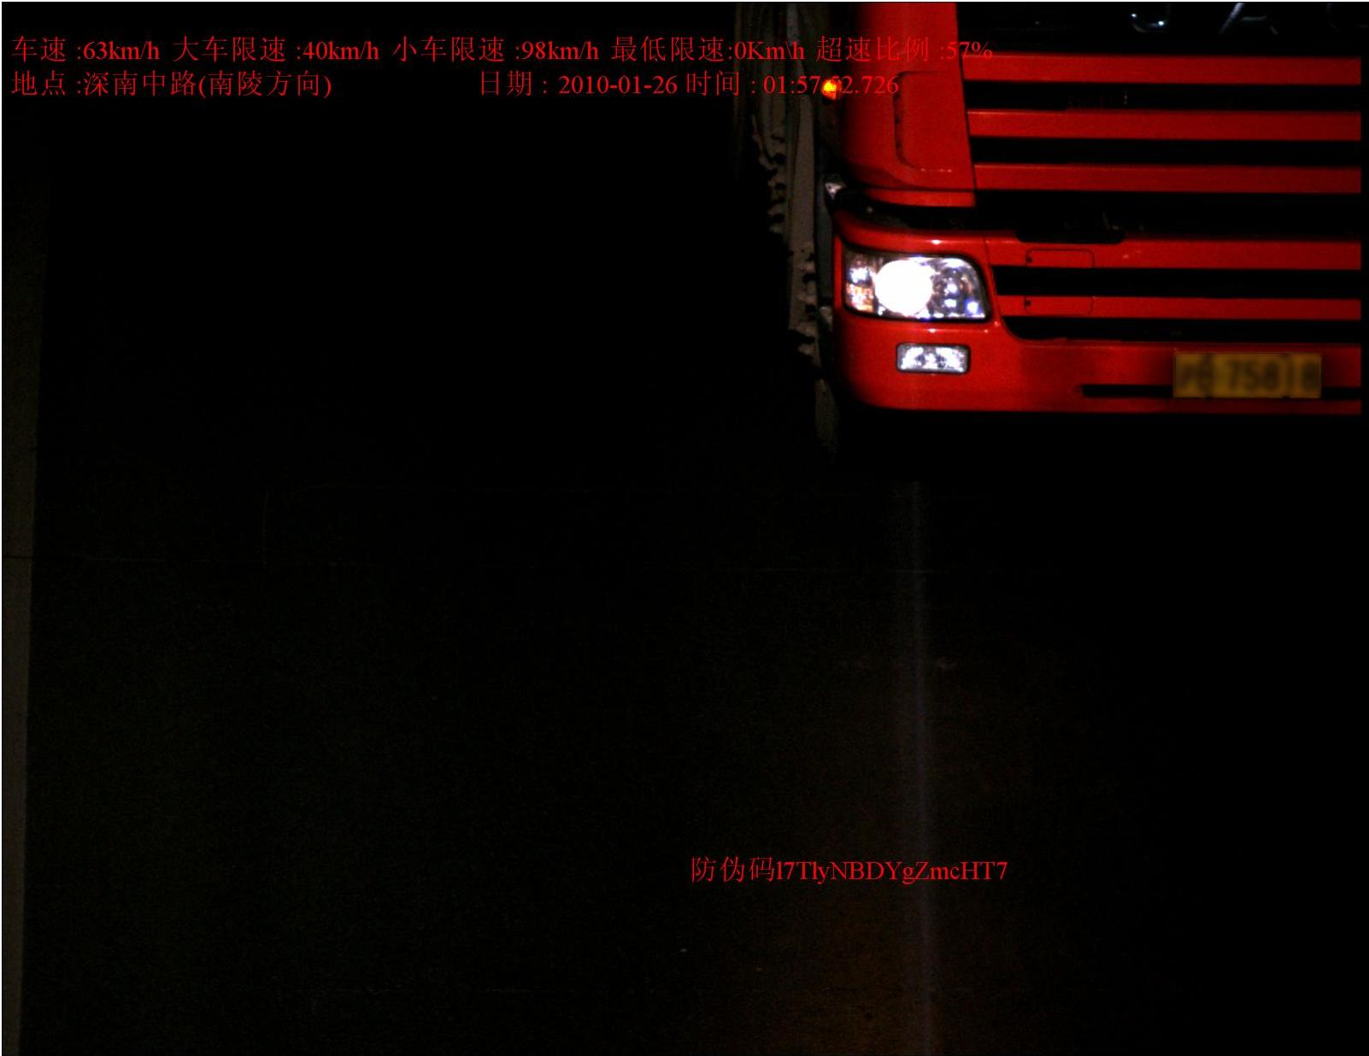
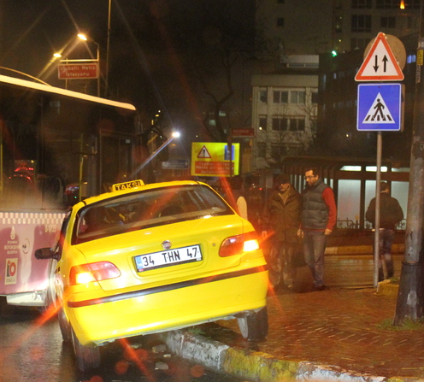
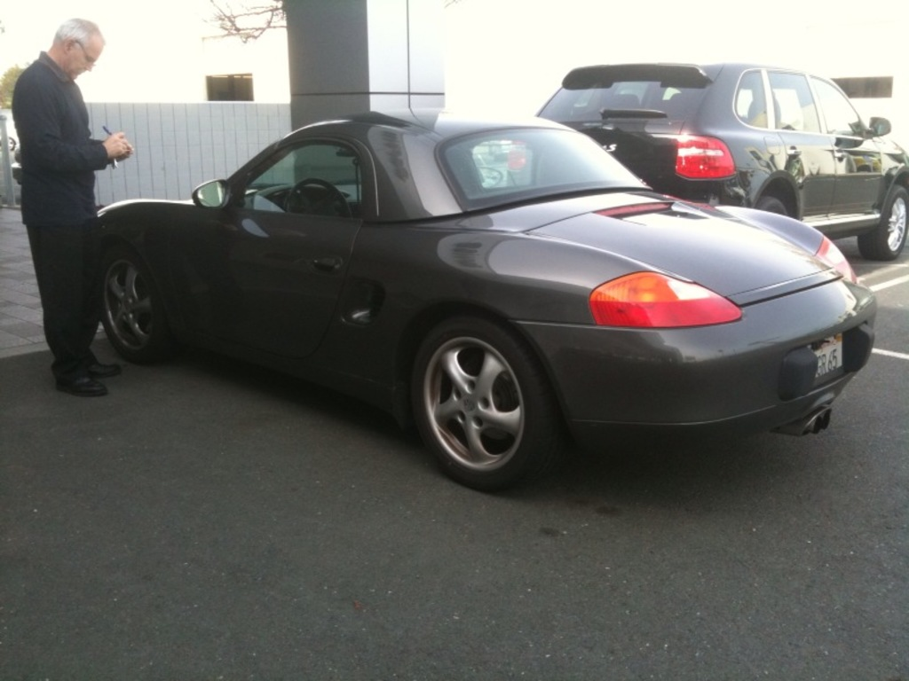
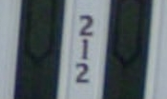
Lessons Learned
Very visually different images with the same label (car)
Creating text labels for testing accuracy with an unlabeled dataset is time consuming
Our dataset that we put together is quite varied, which posed a challenge
For example, when trying to train a small Haar Cascade for car detection, we struggled, likely do to the lack of uniformity in our data
Different types of thresholding worked better for some images
OTSU was most effective overall, but Adaptive Gaussian thresholding worked better for low contrast images
Extracting vertical text was difficult for all OCR methods tested
Vertically stacked numbers were hard to detect

Slide 16
Improvements and Future Work
Preprocessing techniques could be expanded upon
Finding a way to detect when OTSU thresholding vs. Adaptive Gaussian thresholding is appropriate
A more effective deskew approach to fix tilted text
Finding a way to distinguish plate numbers from words on a plate (such as “Illinois”).
Refine dataset
Either increase size, or decrease scope
Our findings underscore the importance of selecting the right image processing technique based on the characteristics of the dataset. While Otsu's method proved effective for high-contrast and bimodal images, Adaptive Gaussian thresholding was better suited for images with non-uniform lighting and low contrast. This reinforces the idea that there is no 'one-size-fits-all' solution in image processing; rather, it requires a careful consideration of the specific challenges posed by each dataset.

Slide 17
Thank you
We are open to any questions

